Slide 1

Healthcare system
Project mid-progress ppresentation

Slide 2
Our system
Will be applicable in any period of time.
The number of patient entries in the database is not limited to any number. It can save the number of patients as much as the hospital requires.
The size of data is not limited since patients data sometimes includes the images and other big file resulting from scanning.

Slide 3
Done tasks list
Create database tables (SQL)
Design images (using Photoshop).
Create & design Login page (home page).
Create & design Doctors page.
Create & design Hospital page.
Create & design Patients page.
Test HTML and CSS.
Login function & retrieving information.

Slide 4
Doing tasks list
Usability testing + Interface Testing.
Code the function with PHP to connect the database with the pages.
Test database with cases checking (register, login, logout, insert data).
Browser Compatibility Test. + Performance Testing.
Hosting the web system on cloud platform.
Functionality Testing.
Linking all the pages using the PHP.
Publishing the website (finalize it).

Slide 5
Tasks might be added in the system
Doctors consultations on various diseases
Diagnosis for diseases.
Providing treatment facilities
Facilities of admitting patients such as provision of beds ,nursing ,medicine and others
Immunization for patients and children

Slide 6
Problem Solved
The software program is to make the system activities automated.
The software system has two categories of users.
The user categories for patients, doctors, nurses and others
The administration level for only system administrator.
The software program of system management will involves;
Maintaining patients details
providing prescriptions for the patients ,precautions and providing balance diet to everyone.
Perform computation of all the details regarding patients and hospital activities at large.

Slide 7
Methods & techniques
List of tools and platforms used during coding:
HTML.
CSS.
php.
JavaScript.
Bootstrap.
phpMyAdmin,.
Wamp Server.
Dreamweaver.
Webstorm.

Slide 8
User features
Every user should be:
• Comfortable of working with computer.
• He must have knowledge in medical field.
• He must also have basic knowledge of English too.
Constraints
GUI is only in English.
Login and password is used for identification of user and there is no facility for
guest.

Slide 9
Entities How can access these data ?
Patients
Doctors or nurses data
Ambulance employee
Health insurance
Hospital data
The entities are connected to the same database,
but each entity has differ access to some information.

Slide 10
Entities functions:
(3) Patient:
-Register new patient.
-Edit patient info.
-Print patient report.
-Access patient insurance .
-Confirm charge service for insurance.
(4) Hospital:
-Retrieve patient info.
-Add new or delete patient to the system.
-Edit patient info.
-Charge service under patient record.
- Access patient insurance .
- Print patient report.
(5) Insurance company:
-Retrieve patient service info.
-Give patient copy of bill info to confirm it
(1) Ambulance staff:
-Retrieve patient info.
-Add new patient.
-Add medicine under patient record.
(2) Doctor:
-Retrieve patient info.
-Add medicine under patient record.
-Add more service under patient record.
-Add description of each service or medicine.
- Write prescription.

Slide 11
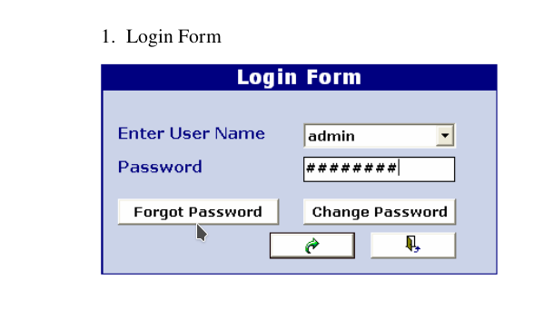
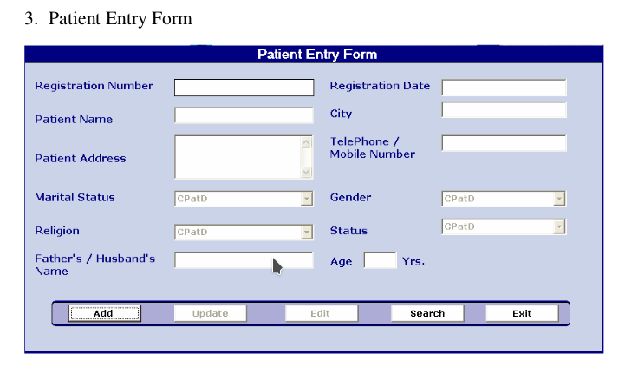
Demo: Login / New Patient

Slide 12
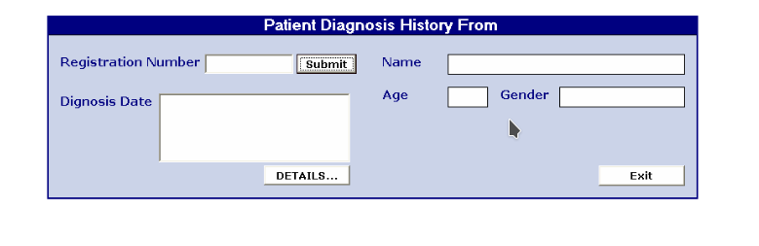
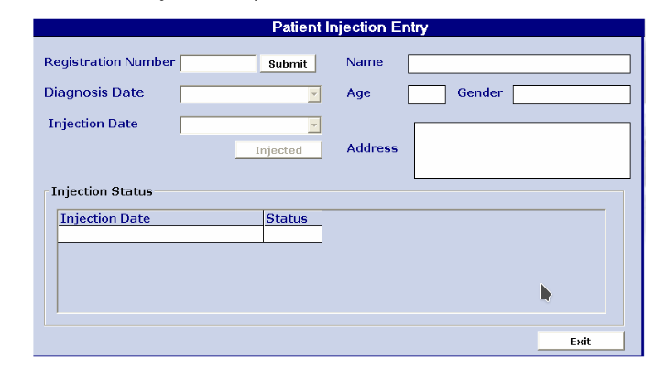
Demo: Patient diagnosis / injection

Slide 13
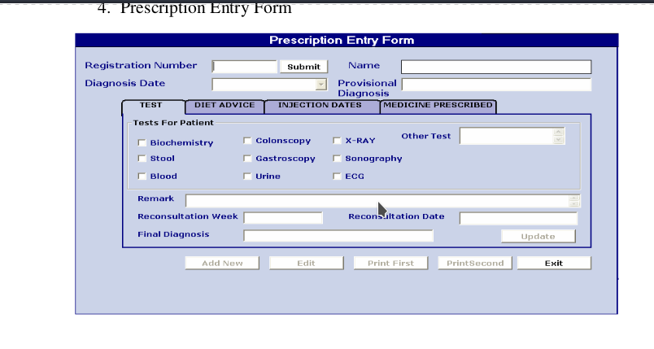
Demo: As Doctor / writing a prescription

Slide 14
Challenges & approaches
Lack of immediate retrievals.
Lack of immediate information storage.
Lack of prompt updating.
Error prone manual calculation.

Slide 15
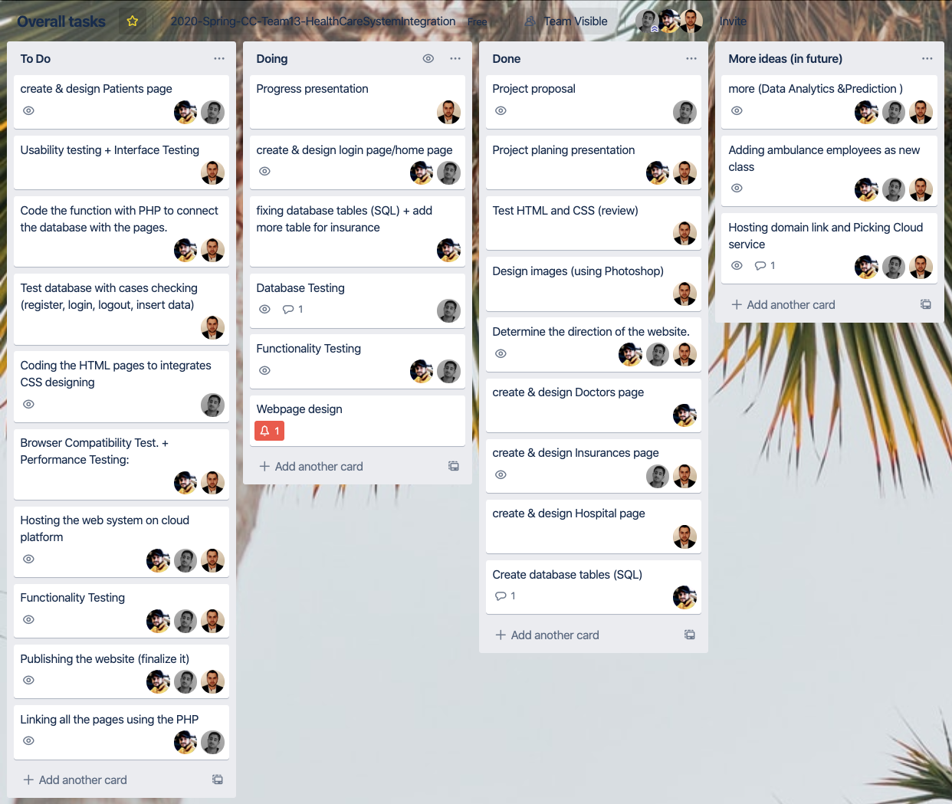
Collaboration & Tasks
About 45% of the work done.

Slide 16
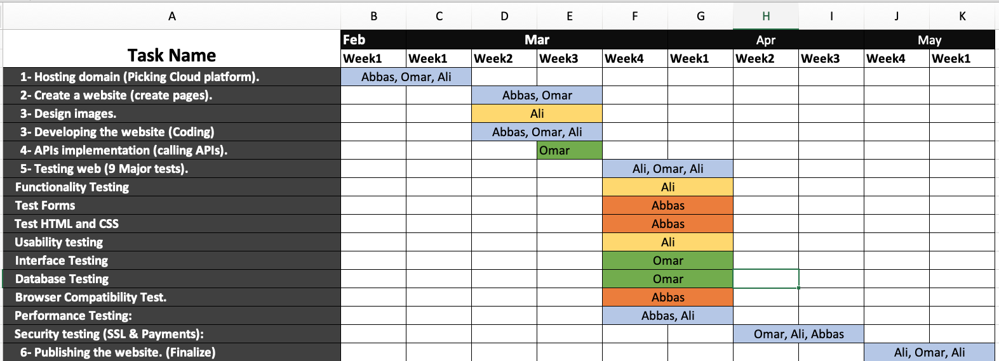
Meeting plan & Schedule
GitHub link: https://github.com/Alshaikh1abbas/CS5525-CC
Trello link: https://trello.com/b/BDzQp7CH/overall-tasks

